Slide 1
Fiber to Waveguide Coupling

Slide 2
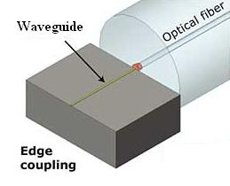
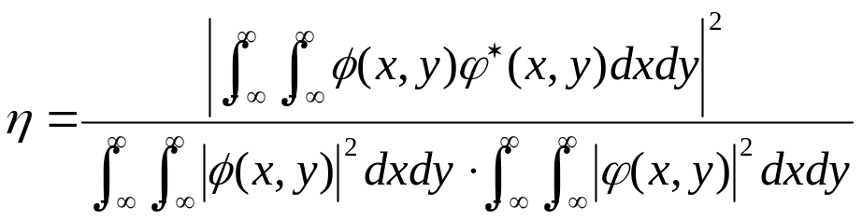
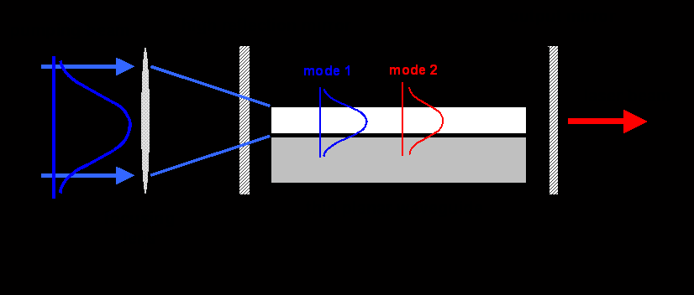


Fiber (or Laser) to Waveguide Coupling
Direct Coupling Efficiency:
where is the laser/fiber mode and is the waveguide mode.

Slide 4
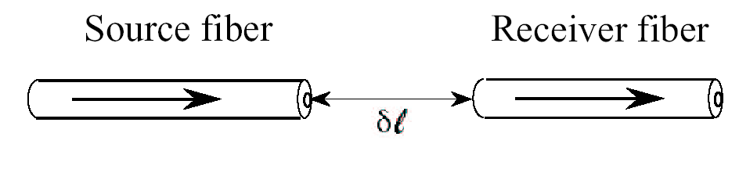
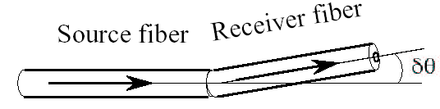
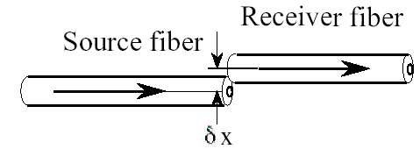
Coupling losses
Lateral Misalignment
Longitudinal Misalignment
Angular Misalignment

Slide 5
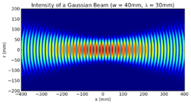
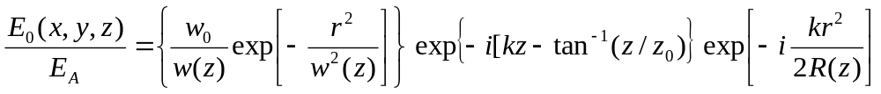
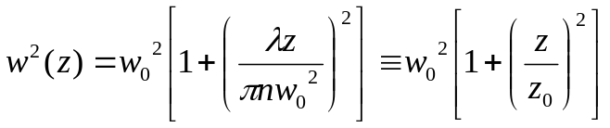
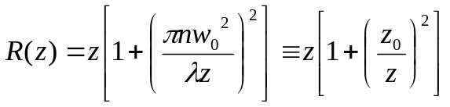
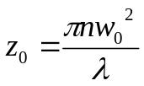
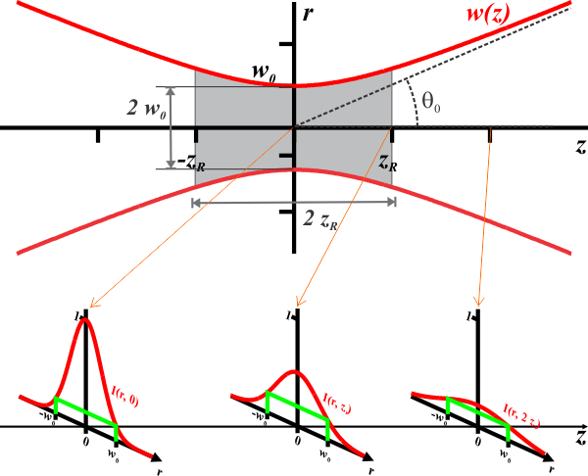
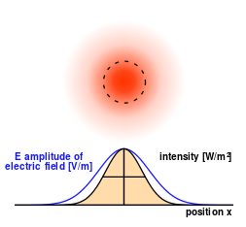
Gaussian beam
where,
: Beam radius
: Radius of curvature of the wave front
: Confocal parameter(2z₀) or Rayleigh range

Slide 6
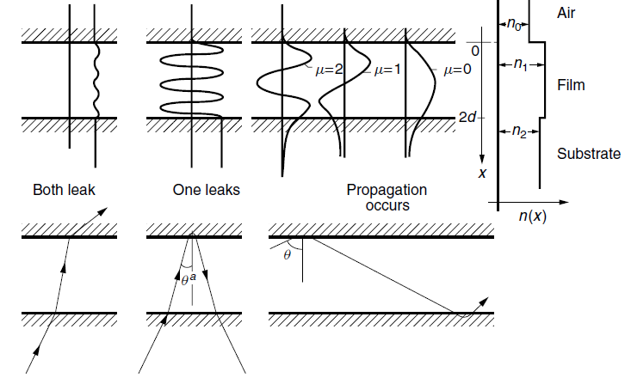
Mode Guiding
Total Internal Reflection

Slide 7
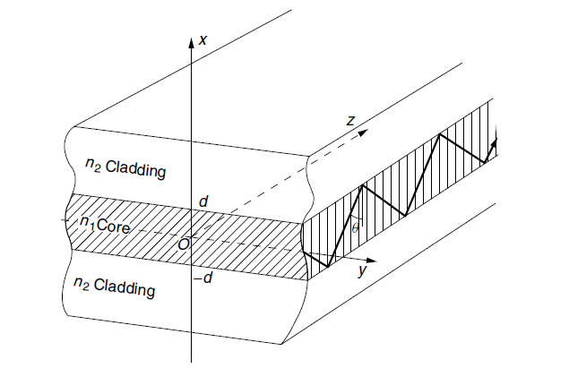

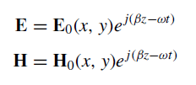
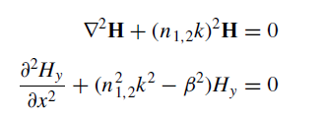
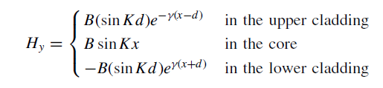
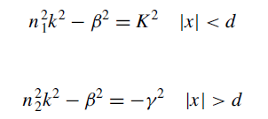
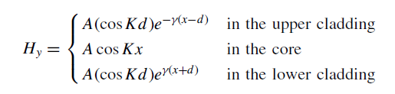
Mode Guiding

Slide 8
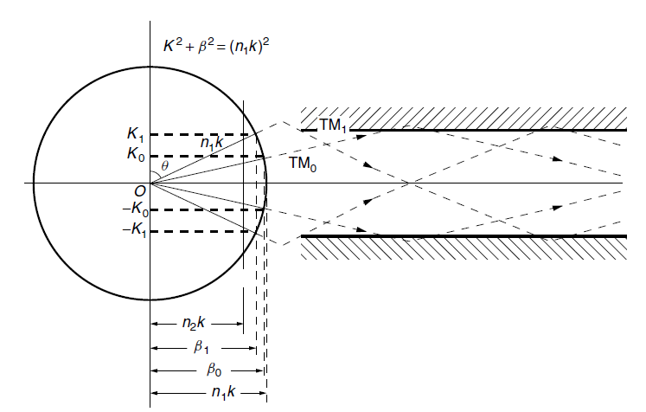
Mode Guiding

Slide 9
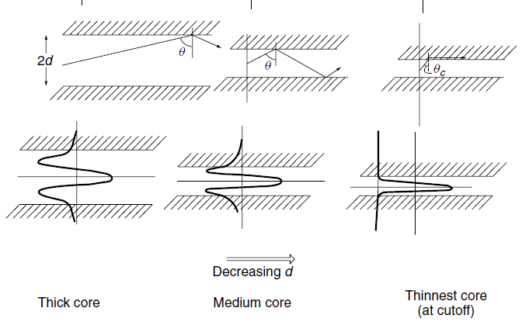
Mode Guiding

Slide 10
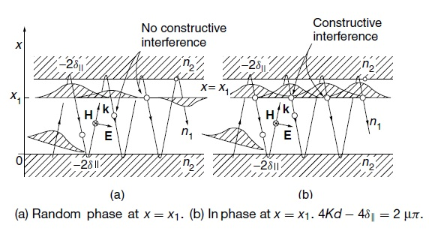
Phase matching

Slide 11


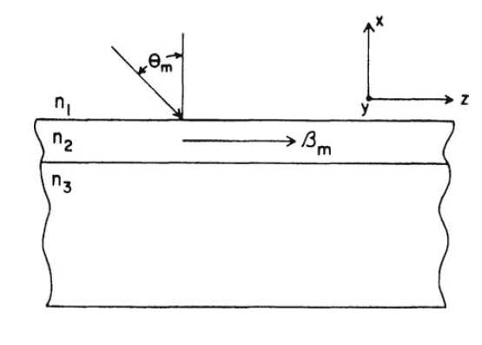

Impossible Coupling!

Slide 12

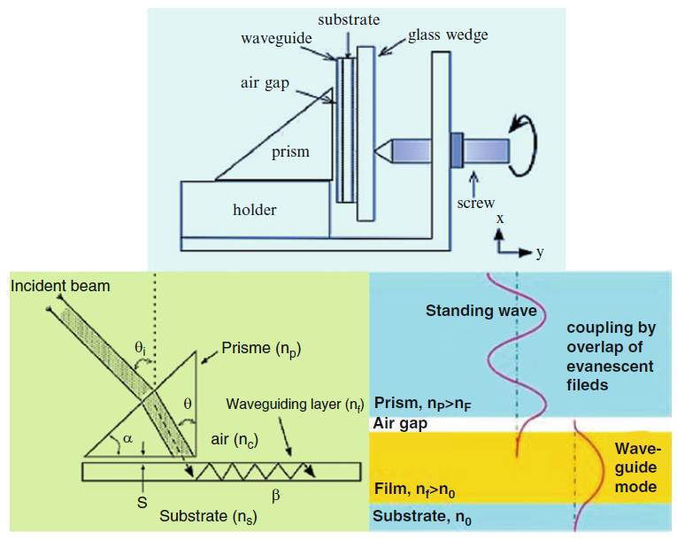


Prism Coupler

Slide 13



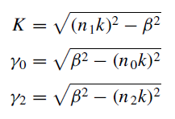
Asymmetric waveguide
n0=1
n1=1.6
n2=1.5

Slide 14
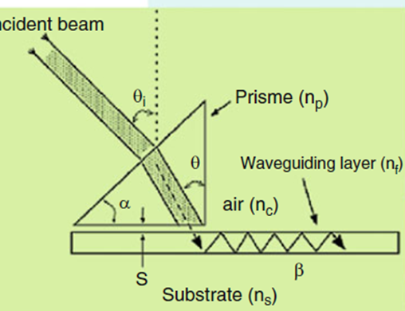

Slide 15
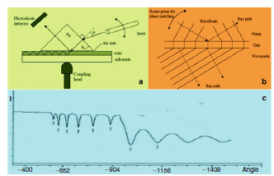
Prism Coupler
Finding of Coupling angle → Mode effective index and Film thickness

Slide 16
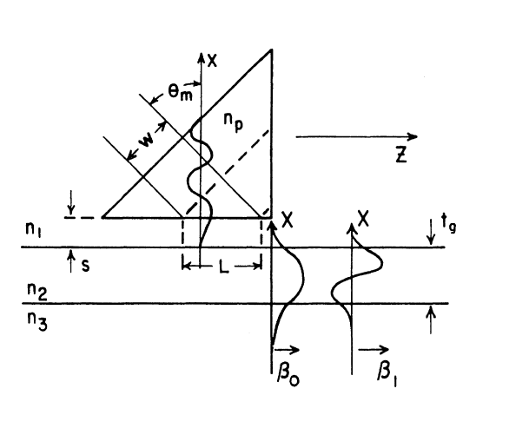

Slide 17
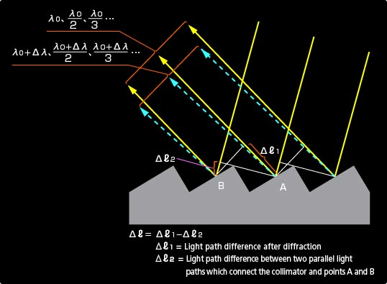
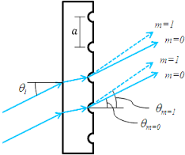
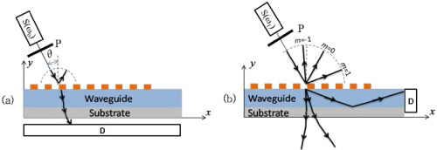
Grating Coupler

Slide 18
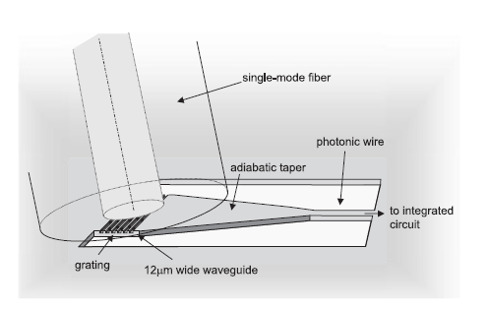
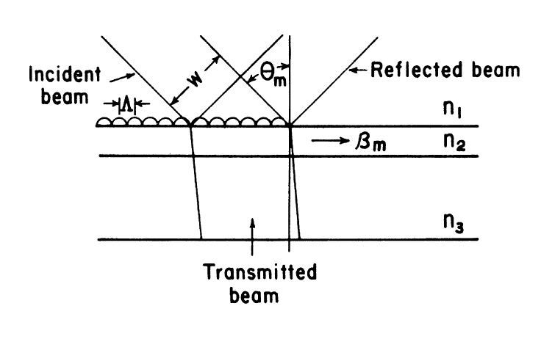
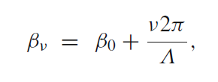

Grating Coupler

Slide 19
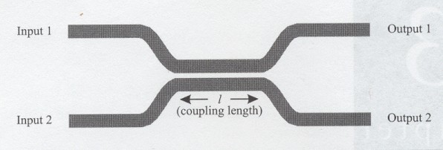

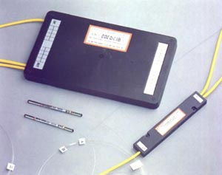
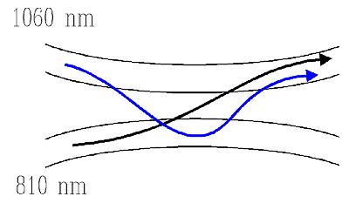
Directional Coupler
directional coupler --- Applications
(1) Signal switch
(2) WDM coupler

Slide 20
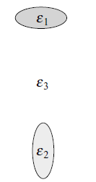
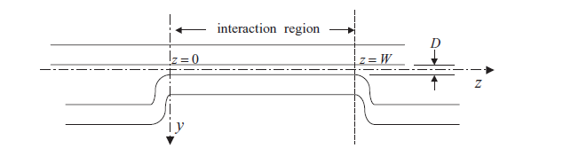
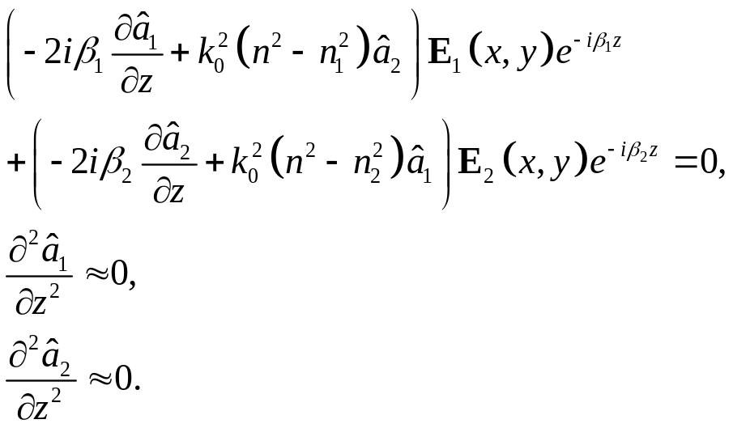
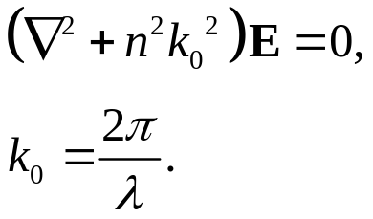
Coupling Mode Theory
The First waveguide electric field: E1
The Second waveguide electric field: E2
By substituting the above equation in the Helmholtz equation:

Slide 21
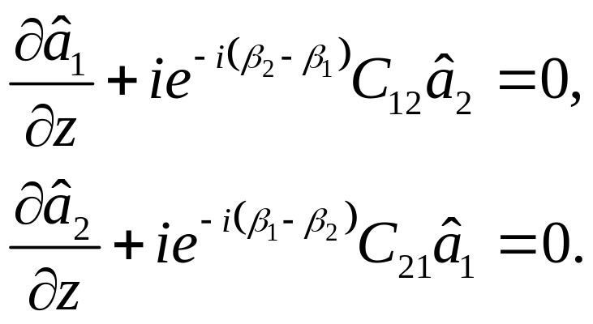
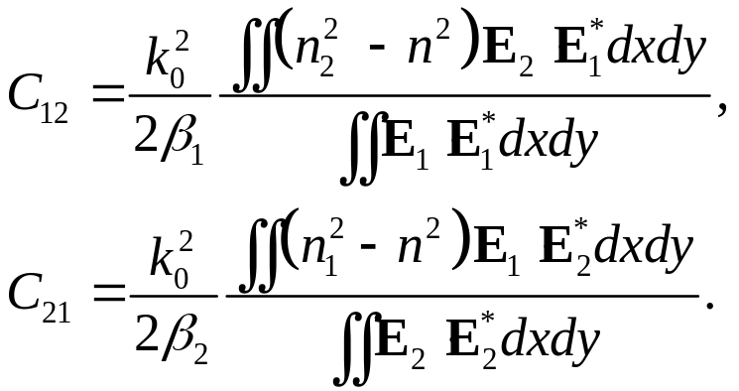
Multiplying the STAR equation by (E1*)
and Integrating the waveguide cross section
Multiplying the STAR equation by (E2*)
and Integrating the waveguide cross section
Coupling Coefficients

Slide 22
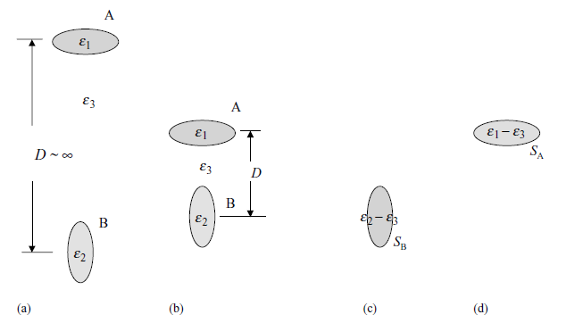
Coupling Constants
On Waveguide Cross sections

Slide 23
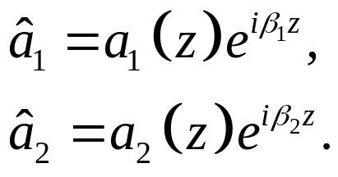
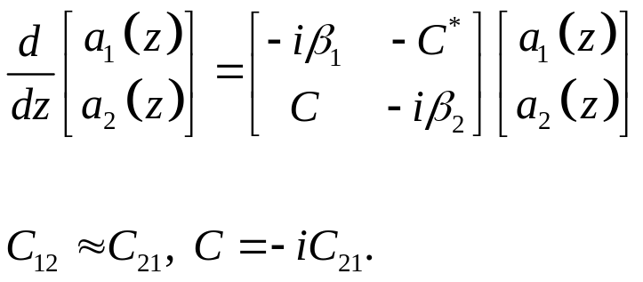
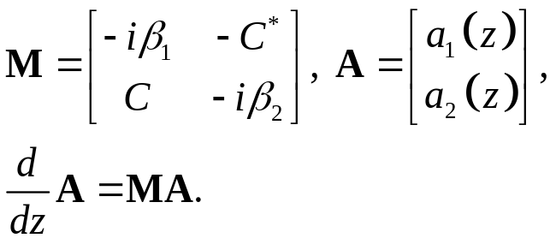
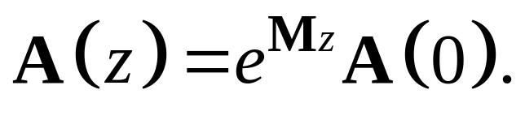

Slide 24
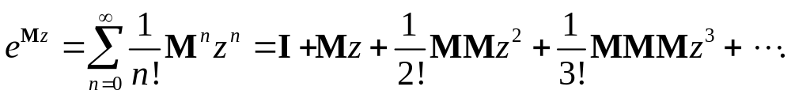



Slide 25




For Symmetric case
Coupling with Variable waveguides conditions:

Slide 26


Multilayer Waveguide Analysis

Slide 27






Mode-coupling
perturbation theory, TE mode
Mode–coupling equation

Slide 28









Mode-coupling in Directional Coupler
directional coupler

Slide 29




Directional Coupler

Slide 30


Slide 31



Conventionally, the directional coupler has two identical channel waveguides.
In that case, CBA = CAB = C, and the ratio is the power distribution among the two waveguides. At z = 0, let there be an input power Iin in waveguide A and no input power in waveguide B. Then the output power Iout in waveguide B after an interaction distance W is given directly by:

Slide 32

Tapers
Adiabatic transition

Slide 33

Y-branch

Slide 34



Mach- zehnder Interferometer

